Slide 1
Overview
Part 1 – Gate Circuits and Boolean Equations
  Binary Logic and Gates
  Boolean Algebra
  Standard Forms
Part 2 – Circuit Optimization
  Two-Level Optimization
  Map Manipulation
  Multi-Level Circuit Optimization
Part 3 – Additional Gates and Circuits
  Other Gate Types
  Exclusive-OR Operator and Gates
  High-Impedance Outputs
Chapter 2 - Part 1 <number>

Slide 2
Binary Logic and Gates
Binary variables take on one of two values.
Logical operators operate on binary values and binary variables.
Basic logical operators are the logic functions AND, OR and NOT.
Logic gates implement logic functions.
Boolean Algebra: a useful mathematical system for specifying and transforming logic functions.
We study Boolean algebra as foundation for designing and analyzing digital systems!
Chapter 2 - Part 1 <number>

Slide 3
Binary Variables
Recall that the two binary values have different names:
  True/False
  On/Off
  Yes/No
  1/0
We use 1 and 0 to denote the two values.
Variable identifier examples:
  A, B, y, z, or X₁ for now
  RESET, START_IT, or ADD1 later
Chapter 2 - Part 1 <number>

Slide 4
Logical Operations
The three basic logical operations are:
  AND
  OR
  NOT
AND is denoted by a dot (·).
OR is denoted by a plus (+).
NOT is denoted by an overbar ( ¯ ), a single quote mark (') after, or (~) before the variable.
Chapter 2 - Part 1 <number>

Slide 5
Notation Examples
Examples:
  is read “Y is equal to A AND B.”
  is read “z is equal to x OR y.”
  is read “X is equal to NOT A.”
Y
=
A
⋅
B
z
=
x
+
y
X
=
A
Note: The statement:
  1 + 1 = 2 (read “one plus one equals two”)
is not the same as
  1 + 1 = 1 (read “1 or 1 equals 1”).
Chapter 2 - Part 1 <number>

Slide 6
Operator Definitions
Operations are defined on the values "0" and "1" for each operator:
AND
OR
NOT
0 · 0 = 0
0 + 0 = 0
0
=
1
0 · 1 = 0
0 + 1 = 1
1
=
0
1 · 0 = 0
1 + 0 = 1
1 · 1 = 1
1 + 1 = 1
Chapter 2 - Part 1 <number>

Slide 7
Truth Tables
Truth table − a tabular listing of the values of a function for all possible combinations of values on its arguments
Example: Truth tables for the basic logic operations:
AND
OR
X | Y | Z = X+Y
0 | 0 | 0
0 | 1 | 1
1 | 0 | 1
1 | 1 | 1
NOT
X
Y
Z = X·Y
X
Z
=
X
0
0
0
0
1
0
1
0
1
0
1
0
0
1
1
1
Chapter 2 - Part 1 <number>

Slide 8
Logic Function Implementation
Using Switches
  For inputs:
    logic 1 is switch closed
    logic 0 is switch open
  For outputs:
    logic 1 is light on
    logic 0 is light off.
  NOT uses a switch such
  that:
    logic 1 is switch open
    logic 0 is switch closed
Switches in parallel => OR
Switches in series => AND
Normally-closed switch => NOT
C
Chapter 2 - Part 1 <number>

Slide 9
Logic Function Implementation (Continued)
Example: Logic Using Switches
Light is on (L = 1) for
  L(A, B, C, D) =
  and off (L = 0), otherwise.
Useful model for relay circuits and for CMOS gate circuits, the foundation of current digital logic technology
B
C
A
D
Chapter 2 - Part 1 <number>
Notes:
L (A, B, C, D) = A ((B C') + D) = A B C' + A D

Slide 10
Logic Gates
In the earliest computers, switches were opened and closed by magnetic fields produced by energizing coils in relays. The switches in turn opened and closed the current paths.
Later, vacuum tubes that open and close current paths electronically replaced relays.
Today, transistors are used as electronic switches that open and close current paths.
Chapter 2 - Part 1 <number>

Slide 11
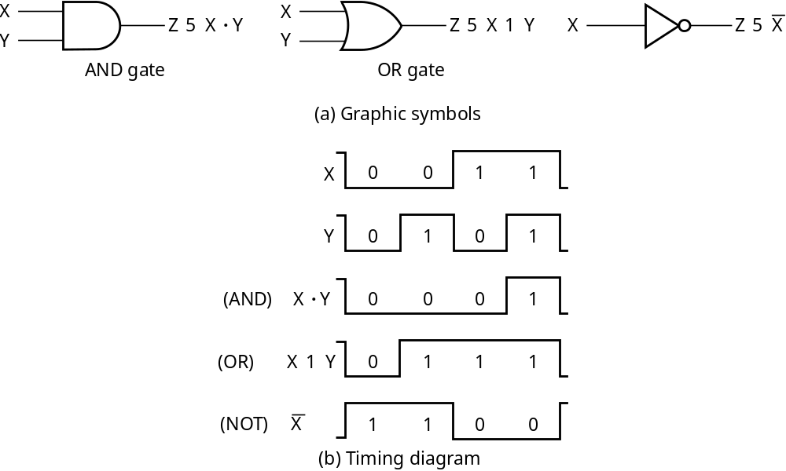
Logic Gate Symbols and Behavior
Logic gates have special symbols:
And waveform behavior in time as follows:
Chapter 2 - Part 1 <number>

Slide 12
Logic Diagrams and Expressions
Truth Table
Equation
X Y Z
F
=
X
+
Y
⋅
Z
0 0 0
0
F
=
X
+
Y
Z
0 0 1
1
0 1 0
0
Logic Diagram
0 1 1
0
X
1 0 0
1
1 0 1
1
Y
F
1 1 0
1
Z
1 1 1
1
Boolean equations, truth tables and logic diagrams describe the same function!
Truth tables are unique; expressions and logic diagrams are not. This gives flexibility in implementing functions.
Chapter 2 - Part 1 <number>

Slide 13
Boolean Algebra
An algebraic structure defined on a set of at least two elements, B, together with three binary operators (denoted +, · and ) that satisfies the following basic identities:
1.
X
+ 0
=
X
2.
X
. 1
=
X
3.
X
1
1
4.
X
. 0
0
+
=
=
5.
X + X
=
X
6.
X . X
=
X
7.
X + X
=
1
8.
X . X
=
0
9.
X = X
10.
X + Y
=
Y + X
11.
XY
=
YX
Commutative
12.
(X + Y)
+
Z
=
X + (Y
+
Z)
13.
(XY)
Z
=
X(Y
Z)
Associative
14.
X(Y +
Z)
=
XY
+
XZ
15.
X
+ YZ
=
(X + Y)
(X + Z)
Distributive
DeMorgan
16.
X + Y
=
X . Y
17.
X . Y
=
X + Y
’
s
Chapter 2 - Part 1 <number>

Slide 14
Some Properties of Identities & the Algebra
If the meaning is unambiguous, we leave out the symbol “·”
The identities above are organized into pairs. These pairs have names as follows:
1-4 Existence of 0 and 1 5-6 Idempotence
7-8 Existence of complement 9 Involution
10-11 Commutative Laws 12-13 Associative Laws
14-15 Distributive Laws 16-17 DeMorgan’s Laws
The dual of an algebraic expression is obtained by interchanging + and · and interchanging 0’s and 1’s.
The identities appear in dual pairs. When there is only one identity on a line the identity is self-dual, i. e., the dual expression = the original expression.
Chapter 2 - Part 1 <number>

Slide 15
Some Properties of Identities & the Algebra (Continued)
Unless it happens to be self-dual, the dual of an expression does not equal the expression itself.
Example: F = (A + C) · B + 0
dual F = (A · C + B) · 1 = A · C + B
Example: G = X · Y + (W + Z)
dual G =
Example: H = A · B + A · C + B · C
dual H =
Are any of these functions self-dual?
Chapter 2 - Part 1 <number>
Notes:
Dual G = ((X+Y) · (W · Z)') = ((X+Y) ·(W' + Z')
Dual H = (A + B)(A + C)(B + C). Using the Boolean identities,
= (A +BC) (B+C) = AB + AC + BC. So H is self-dual.

Slide 16
Some Properties of Identities & the Algebra
(Continued)
There can be more that 2 elements in B, i. e., elements other than 1 and 0. What are some common useful Boolean algebras with more than 2 elements?
  1.
  2.
If B contains only 1 and 0, then B is called the switching algebra which is the algebra we use most often.
Algebra of Sets
Algebra of n-bit binary vectors
Chapter 2 - Part 1 <number>
Notes:
Algebra of Sets correspondence to switching algebra: Set - variable,
Union - OR, Intersect AND ., Universe - 1, Empty set - 0,
Complement of Set - NOT, Subset – AND of variables and variable complements.
Algebra of n-bit binary vectors correspondence to switching algebra:
{n-bit binary vectors} – {0,1}, bitwise OR - OR, bitwise AND - AND,
bitwise NOT - NOT, Vector of all 1s – 1, Vector of all 0s – 0.

Slide 17
Boolean Operator Precedence
The order of evaluation in a Boolean
expression is:
1.
Parentheses
2.
NOT
3.
AND
4.
OR
Consequence: Parentheses appear
around OR expressions
Example: F = A(B + C)(C + D)
Chapter 2 - Part 1 <number>

Slide 18
Example 1: Boolean Algebraic Proof
A + A·B = A (Absorption Theorem)
Proof Steps Justification (identity or theorem)
A + A·B
= A · 1 + A · B X = X · 1
= A · ( 1 + B) X · Y + X · Z = X ·(Y + Z)(Distributive Law)
= A · 1 1 + X = 1
= A X · 1 = X
Our primary reason for doing proofs is to learn:
  Careful and efficient use of the identities and theorems of Boolean algebra, and
  How to choose the appropriate identity or theorem to apply to make forward progress, irrespective of the application.
Chapter 2 - Part 1 <number>

Slide 19
Example 2: Boolean Algebraic Proofs
AB + AC + BC = AB + AC (Consensus Theorem)
Proof Steps Justification (identity or theorem)
AB + AC + BC
= AB + AC + 1 · BC ?
= AB +AC + (A + A) · BC ?
=
Chapter 2 - Part 1 <number>
Notes:
Justification 1: 1 . X = X
Justification 2: X + X’ = 1
= AB + A’C + ABC + A’BC X(Y + Z) = XY + XZ (Distributive Law)
= AB + ABC + A’C + A’BC X + Y = Y + X (Commutative Law)
= AB . 1 + ABC + A’C . 1 + A’C . B X . 1 = X, X . Y = Y . X (Commutative Law)
= AB (1 + C) + A’C (1 + B) X(Y + Z) = XY +XZ (Distributive Law)
= AB . 1 + A’C . 1 = AB + A’C X . 1 = X

Slide 20
Example 3: Boolean Algebraic Proofs
Proof Steps Justification (identity or theorem)
=
(
X
+
Y
)
Z
+
X
Y
=
Y
(
X
+
Z
)
(
X
+
Y
)
Z
+
X
Y
Chapter 2 - Part 1 <number>
Notes:
= X’ Y’ Z + X Y’ (A + B)’ = A’ . B’ (DeMorgan’s Law)
= Y’ X’ Z + Y’ X A . B = B . A (Commutative Law)
= Y’ (X’ Z + X) A(B + C) = AB + AC (Distributive Law)
= Y’ (X’ + X)(Z + X) A + BC = (A + B)(A + C) (Distributive Law)
= Y’ . 1 . (Z + X) A + A’ = 1
= Y’ (X + Z) 1 . A = A, A + B = B + A (Commutative Law)

Slide 21
Useful Theorems
(
)
(
)
x
⋅
y
+
x
⋅
y
=
y
x
+
y
x
+
y
=
y
M
inimizatio
n
(
)
x
+
x
⋅
y
=
x
+
y
x
⋅
x
+
y
=
x
⋅
y
Simplifica
tion
x
⋅
y
+
x
⋅
z
+
y
⋅
z
=
x
⋅
y
+
x
⋅
z
Consensus
(
)
(
)
(
)
(
)
(
)
x
+
y
⋅
x
+
z
⋅
y
+
z
=
x
+
y
⋅
x
+
z
x
+
y
=
x
⋅
y
x
⋅
y
=
x
+
y
DeMorgan'
s
Laws
Chapter 2 - Part 1 <number>

Slide 22
Proof of Simplification
(
)
(
)
x
⋅
y
+
x
⋅
y
=
y
x
+
y
x
+
y
=
y
Chapter 2 - Part 1 <number>
Notes:
x . y + x’ . y
= (x ⁺ x’) . y X(Y + Z) = XY + XZ (Distributive Law)
= 1 . y X + X’ = 1
= y X . 1 = X

Slide 23
Proof of DeMorgan’s Laws
x
+
y
=
x
⋅
y
x
⋅
y
=
x
+
y
Chapter 2 - Part 1 <number>
Notes:
It is important that we do not USE DeMorgan’s Laws in doing this proof.
This requires a different proof method. We will show that, x’ . y’, satisfies
the definition of the complement of (x + y), defined as (x + y)’ by
DeMorgan’s Law.
To show this we need to show that A + A’ = 1 and A.A’ = 0 with
A = x + y and A’ = x’. y’. This proves that x’. y’ = (x + y)’.
Part 1: Show x + y + x’. y’ = 1.
x + y + x’. y’
= (x + y + x’) (x + y + y’) X + YZ = (X + Y)(X + Z) (Distributive Law)
= (x + x’ + y) (x + y + y’) X + Y = Y + X (Commutative Law)
= (1 + y)(x + 1) X + X’ = 1
= 1 . 1 1 + X = 1
= 1 1 . X = 1
Part 2: Show (x + y) . x’. y’ = 0.
(x + y) . x’. y’
= (x . x’. y’ + y . x’. y’) X (Y + Z) = XY + XZ (Distributive Law)
= (x . x’. y’ + y . y’ . x’) XY = YX (Commutative Law)
= (0 . y’ + 0 . x’) X . X’ = 0
= (0 + 0) 0 . X = 0
= 0 X + 0 = X (With X = 0)
Based on the above two parts, x’y’ = (x + y)’
The second DeMorgans’ law is proved by duality. Note that DeMorgan’s
Law, given as an identity is not an axiom in the sense that it can be
proved using the other identities.

Slide 24
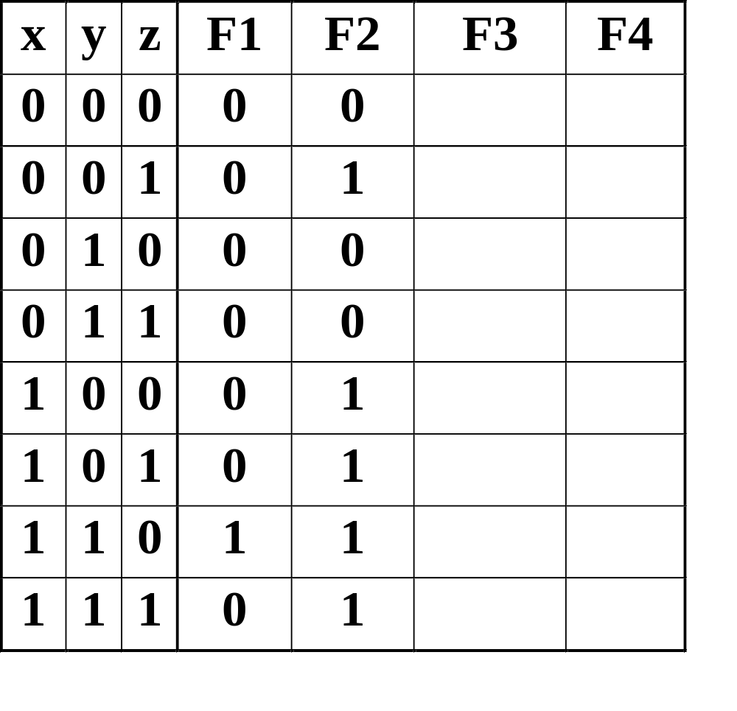
Boolean Function Evaluation
F1
=
xy
z
F2
=
x
+
y
z
F3
=
x
y
z
+
x
y
z
+
x
y
F4
=
x
y
+
x
z
Chapter 2 - Part 1 <number>
Notes:
F3 is 1 for x’y’z’, x’yz, xy’z’ and xy’z => F3 = 1,0,0,1,1,1,0,0
F4 is 1 for xy’z’, xy’z, x’y’z and x’y z => F4 = 0,1,0,1,1,1,0,0

Slide 25
Expression Simplification
An application of Boolean algebra
Simplify to contain the smallest number of literals (complemented and uncomplemented variables):
= AB + ABCD + A C D + A C D + A B D
= AB + AB(CD) + A C (D + D) + A B D
= AB + A C + A B D = B(A + AD) +AC
= B (A + D) + A C 5 literals
A
B
+
A
C
D
+
A
B
D
+
A
C
D
+
A
B
C
D
Chapter 2 - Part 1 <number>

Slide 26
Complementing Functions
Use DeMorgan's Theorem to complement a function:
  1. Interchange AND and OR operators
  2. Complement each constant value and literal
Example: Complement F =
F = (x + y + z)(x + y + z)
Example: Complement G = (a + bc)d + e
G =
x
y
z
+
x
y
z
Chapter 2 - Part 1 <number>

Slide 27
Venn Diagram
A diagram representing mathematical or logical sets pictorially as circles or closed curves within an enclosing rectangle (the universal set), common elements of the sets being represented by the areas of overlap among the circles.
Chapter 2 - Part 1 <number>

Slide 28
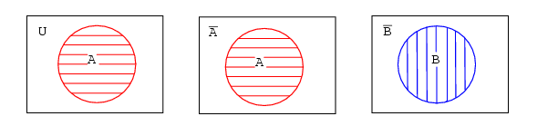
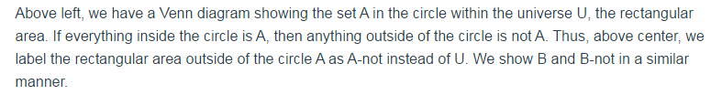
Venn Diagram....Example
Chapter 2 - Part 1 <number>

Slide 29
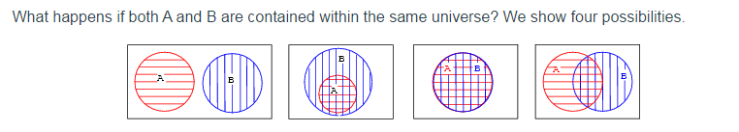
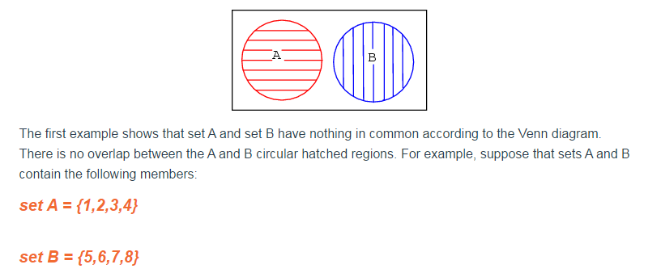
Venn Diagram....Example
Chapter 2 - Part 1 <number>

Slide 30
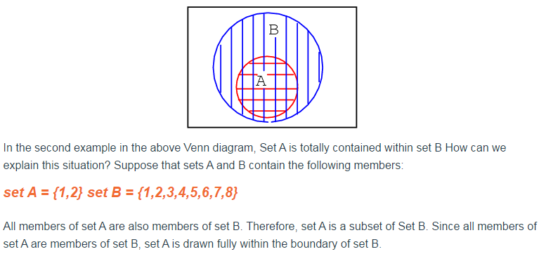
Continue....
Chapter 2 - Part 1 <number>

Slide 31
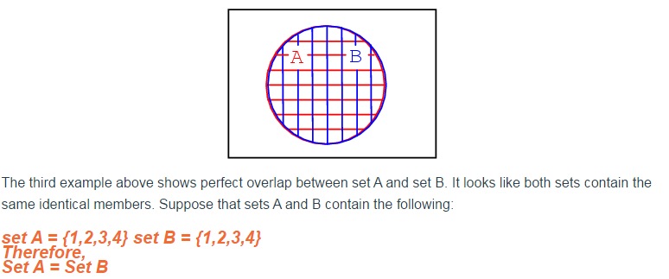
Continue....
Chapter 2 - Part 1 <number>

Slide 32
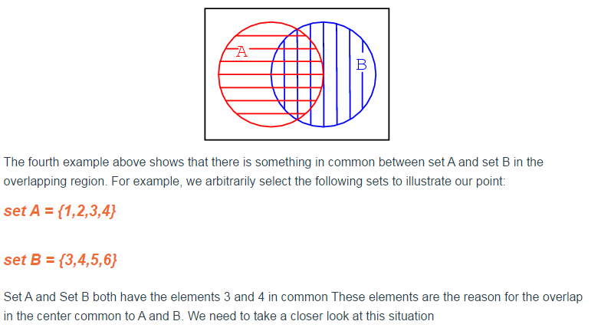
Continue....
Chapter 2 - Part 1 <number>

Slide 33
Overview – Canonical Forms
What are Canonical Forms?
Minterms and Maxterms
Index Representation of Minterms and Maxterms
Sum-of-Minterm (SOM) Representations
Product-of-Maxterm (POM) Representations
Representation of Complements of Functions
Conversions between Representations
Chapter 2 - Part 1 <number>

Slide 34
Canonical Forms
It is useful to specify Boolean functions in a form that:
  Allows comparison for equality.
  Has a correspondence to the truth tables
Canonical Forms in common usage:
  Sum of Minterms (SOM)
  Product of Maxterms (POM)
Chapter 2 - Part 1 <number>

Slide 35
Minterms
Minterms are AND terms with every variable present in either true or complemented form.
Given that each binary variable may appear normal (e.g., x) or complemented (e.g., ), there are 2^{n} minterms for n variables.
Example: Two variables (X and Y)produce
2 x 2 = 4 combinations:
  (both normal)
  (X normal, Y complemented)
  (X complemented, Y normal)
  (both complemented)
Thus there are four minterms of two variables.
x
XY
X
Y
X
Y
X
Y
Chapter 2 - Part 1 <number>

Slide 36
Maxterms
Maxterms are OR terms with every variable in true or complemented form.
Given that each binary variable may appear normal (e.g., x) or complemented (e.g., x), there are 2^{n} maxterms for n variables.
Example: Two variables (X and Y) produce
2 x 2 = 4 combinations:
  (both normal)
  (x normal, y complemented)
  (x complemented, y normal)
  (both complemented)
X
+
Y
X
+
Y
X
+
Y
X
+
Y
Chapter 2 - Part 1 <number>

Slide 37
Maxterms and Minterms
Examples: Two variable minterms and maxterms.
The index above is important for describing which variables in the terms are true and which are complemented.
Index | Minterm | Maxterm
0 | x y | x + y
1 | x y | x + y
2 | x y | x + y
3 | x y | x + y
Chapter 2 - Part 1 <number>

Slide 38
Standard Order
Minterms and maxterms are designated with a subscript
The subscript is a number, corresponding to a binary pattern
The bits in the pattern represent the complemented or normal state of each variable listed in a standard order.
All variables will be present in a minterm or maxterm and will be listed in the same order (usually alphabetically)
Example: For variables a, b, c:
  Maxterms: (a + b + c), (a + b + c)
  Terms: (b + a + c), a c b, and (c + b + a) are NOT in standard order.
  Minterms: a b c, a b c, a b c
  Terms: (a + c), b c, and (a + b) do not contain all variables
Chapter 2 - Part 1 <number>

Slide 39
Purpose of the Index
The index for the minterm or maxterm, expressed as a binary number, is used to determine whether the variable is shown in the true form or complemented form.
For Minterms:
  “1” means the variable is “Not Complemented” and
  “0” means the variable is “Complemented”.
For Maxterms:
  “0” means the variable is “Not Complemented” and
  “1” means the variable is “Complemented”.
Chapter 2 - Part 1 <number>

Slide 40
Index Example in Three Variables
Example: (for three variables)
Assume the variables are called X, Y, and Z.
The standard order is X, then Y, then Z.
The Index 0 (base 10) = 000 (base 2) for three variables). All three variables are complemented for minterm 0 ( ) and no variables are complemented for Maxterm 0 (X,Y,Z).
  Minterm 0, called m₀ is .
  Maxterm 0, called M₀ is (X + Y + Z).
  Minterm 6 ?
  Maxterm 6 ?
X
,
Y
,
Z
X
Y
Z
Chapter 2 - Part 1 <number>
Notes:
m6 = X Y Z’
M6 = (X’ + Y’ + Z)

Slide 41


Index Examples – Four Variables
Index Binary Minterm Maxterm
i Pattern m_{i} M_{i}
0 0000
1 0001
3 0011
5 0101
7 0111
10 1010
13 1101
15 1111
a
b
c
d
a
b
c
d
?
?
a
+
b
+
c
+
d
a
b
c
d
a
+
b
+
c
+
d
?
a
+
b
+
c
+
d
a
b
c
d
a
+
b
+
c
+
d
a
b
c
d
?
a
+
b
+
c
+
d
Chapter 2 - Part 1 <number>
Notes:
M1 = a + b + c + d’
m3 = a’ b’ c d
m7 = a’ b c d
M 13 = a’ + b’ + c + d’

Slide 42
Minterm and Maxterm Relationship
Review: DeMorgan's Theorem
and
Two-variable example:
and
Thus M₂ is the complement of m₂ and vice-versa.
Since DeMorgan's Theorem holds for n variables, the above holds for terms of n variables
giving:
and
Thus M_{i} is the complement of m_{i}.
x
·
y
=
x
+
y
x
+
y
=
x
⋅
y
M
=
x
+
y
m
=
x·
y
2
2
M
=
m
m
=
M
i
i
i
i
Chapter 2 - Part 1 <number>

Slide 43
Function Tables for Both
Minterms of Maxterms of
2 variables 2 variables
Each column in the maxterm function table is the complement of the column in the minterm function table since M_{i} is the complement of m_{i}.
x y
m
m
m
m
x y
M
M
M
M
0
1
2
3
0
1
2
3
0 0
1
0
0
0
0 0
0
1
1
1
0 1
0
1
0
0
0 1
1
0
1
1
1 0
0
0
1
0
1 0
1
1
0
1
1 1
0
0
0
1
1 1
1
1
1
0
Chapter 2 - Part 1 <number>

Slide 44
Observations
In the function tables:
  Each minterm has one and only one 1 present in the 2^{n} terms (a minimum of 1s). All other entries are 0.
  Each maxterm has one and only one 0 present in the 2^{n} terms All other entries are 1 (a maximum of 1s).
We can implement any function by "ORing" the minterms corresponding to "1" entries in the function table. These are called the minterms of the function.
We can implement any function by "ANDing" the maxterms corresponding to "0" entries in the function table. These are called the maxterms of the function.
This gives us two canonical forms:
  Sum of Minterms (SOM)
  Product of Maxterms (POM)
for stating any Boolean function.
Chapter 2 - Part 1 <number>

Slide 45
Minterm Function Example
Example: Find F₁ = m₁ + m₄ + m₇
F1 = x y z + x y z + x y z
x y z
index
m₁
+
m₄
+
m₇
= F₁
0 0 0
0
0
+
0
+
0
= 0
0 0 1
1
1
+
0
+
0
= 1
0 1 0
2
0
+
0
+
0
= 0
0 1 1
3
0
+
0
+
0
= 0
1 0 0
4
0
+
1
+
0
= 1
1 0 1
5
0
+
0
+
0
= 0
1 1 0
6
0
+
0
+
0
= 0
1 1 1
7
0
+
0
+
1
= 1
Chapter 2 - Part 1 <number>

Slide 46
Minterm Function Example
F(A, B, C, D, E) = m₂ + m₉ + m₁₇ + m₂₃
F(A, B, C, D, E) =
Chapter 2 - Part 1 <number>
Notes:
F(A,B,C,D,E) = A’B’C’DE’ + A’BC’D’E + AB’C’D’E + AB’CDE

Slide 47
Maxterm Function Example
Example: Implement F1 in maxterms:
F₁ = M₀ · M₂ · M₃ · M₅ · M₆
F
=
(x
+
y
+
z)
·(x
+
y
+
z)·(x
+
y
+
z
)
1
·(
x
+
y
+
z
)·(
x
+
y
+
z)
x y z
i
M₀
⋅
M₂
⋅
M₃
⋅
M₅
⋅
M₆
= F1
0 0 0
0
0
⋅
1
⋅
1
⋅
1
⋅
1
= 0
0 0 1
1
1
⋅
1
⋅
1
⋅
1
⋅
1
= 1
0 1 0
2
1
⋅
0
⋅
1
⋅
1
⋅
1
= 0
0 1 1
3
1
⋅
1
⋅
0
⋅
1
⋅
1
= 0
1 0 0
4
1
⋅
1
⋅
1
⋅
1
⋅
1
= 1
1 0 1
5
1
⋅
1
⋅
1
⋅
0
⋅
1
= 0
1 1 0
6
1
⋅
1
⋅
1
⋅
1
⋅
0
= 0
1 1 1
7
1
⋅
1
⋅
1
⋅
1
⋅
1
= 1
Chapter 2 - Part 1 <number>

Slide 48
Maxterm Function Example
F(A, B,C,D) =
F
(
A
,
B
,
C
,
D
)
=
M
⋅
M
⋅
M
⋅
M
3
8
11
14
Chapter 2 - Part 1 <number>
Notes:
F = (A + B + C’ + D’) (A’ + B + C + D) (A’ + B + C’ + D’) (A’ + B’ + C’ + D)

Slide 49
Canonical Sum of Minterms
Any Boolean function can be expressed as a Sum of Minterms.
  For the function table, the minterms used are the terms corresponding to the 1's
  For expressions, expand all terms first to explicitly list all minterms. Do this by “ANDing” any term missing a variable v with a term ( ).
Example: Implement as a sum of minterms.
  First expand terms:
  Then distribute terms:
  Express as sum of minterms: f = m₃ + m₂ + m₀
v
+
v
f
=
x
+
x
y
f
=
x
(
y
+
y
)
+
x
y
f
=
xy
+
x
y
+
x
y
Chapter 2 - Part 1 <number>

Slide 50
Another SOM Example
F
=
A
+
B
C
Example:
There are three variables, A, B, and C which we take to be the standard order.
Expanding the terms with missing variables:
Collect terms (removing all but one of duplicate terms):
Express as SOM:
Chapter 2 - Part 1 <number>
Notes:
F = A(B + B’)(C + C’) + (A + A’) B’ C
= ABC + ABC’ + AB’C + AB’C’ + AB’C + A’B’C
= ABC + ABC’ + AB’C + AB’C’ + A’B’C
= m7 + m6 + m5 + m4 + m1 = m1 + m4 + m5 + m6 + m7

Slide 51
Shorthand SOM Form
From the previous example, we started with:
We ended up with:
F = m₁+m₄+m₅+m₆+m₇
This can be denoted in the formal shorthand:
Note that we explicitly show the standard variables in order and drop the “m” designators.
F
=
A
+
B
C
Chapter 2 - Part 1 <number>

Slide 52
Canonical Product of Maxterms
Any Boolean Function can be expressed as a Product of Maxterms (POM).
  For the function table, the maxterms used are the terms corresponding to the 0's.
  For an expression, expand all terms first to explicitly list all maxterms. Do this by first applying the second distributive law , “ORing” terms missing variable v with a term equal to and then applying the distributive law again.
Example: Convert to product of maxterms:
  Apply the distributive law:
  Add missing variable z:
  Express as POM: f = M₂ · M₃
v
⋅
v
f
(
x
,
y
,
z
)
=
x
+
x
y
x
+
x
y
=
(x
+
x
)(x
+
y
)
=
1
⋅
(x
+
y
)
=
x
+
y
x
+
y
+
z
⋅
z
=
(
x
+
y
+
z
)
(
x
+
y
+
z
)
Chapter 2 - Part 1 <number>

Slide 53
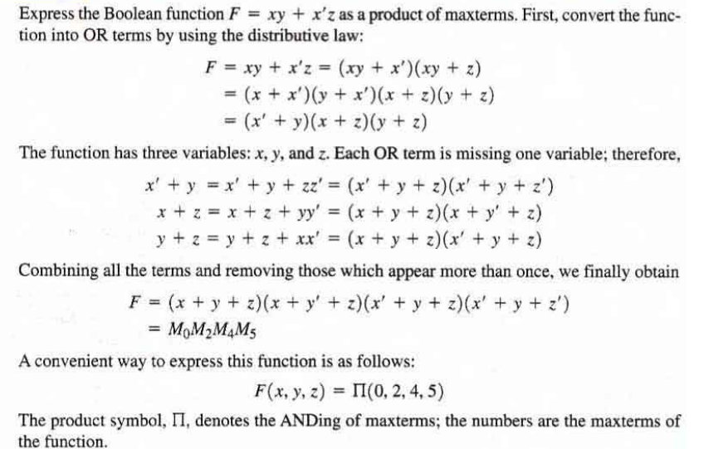
Product of Maxterm
Chapter 2 - Part 1 <number>

Slide 54
Function Complements
The complement of a function expressed as a sum of minterms is constructed by selecting the minterms missing in the sum-of-minterms canonical forms.
Alternatively, the complement of a function expressed by a Sum of Minterms form is simply the Product of Maxterms with the same indices.
Example: Given
F
(
x
,
y
,
z
)
=
Σ
(
1
,
3
,
5
,
7
)
m
F
(
x
,
y
,
z
)
=
Σ
(
0
,
2
,
4
,
6
)
m
F
(
x
,
y
,
z
)
=
Π
(
1
,
3
,
5
,
7
)
M
Chapter 2 - Part 1 <number>

Slide 55


Conversion Between Forms
To convert between sum-of-minterms and product-of-maxterms form (or vice-versa) we follow these steps:
  Find the function complement by swapping terms in the list with terms not in the list.
  Change from products to sums, or vice versa.
Example:Given F as before:
Form the Complement:
Then use the other form with the same indices – this
forms the complement again, giving the other form of the original function:
F
(
x
,
y
,
z
)
=
Σ
(
0
,
2
,
4
,
6
)
m
Chapter 2 - Part 1 <number>

Slide 56
Standard Forms
Standard Sum-of-Products (SOP) form: equations are written as an OR of AND terms
Standard Product-of-Sums (POS) form: equations are written as an AND of OR terms
Examples:
  SOP:
  POS:
These “mixed” forms are neither SOP nor POS
A
B
C
+
A
B
C
+
B
(A
+
B)
·
(A
+
B
+
C
)
·
C
(A
B
+
C)
(A
+
C)
A
B
C
+
A
C
(A
+
B)
Chapter 2 - Part 1 <number>

Slide 57
Standard Sum-of-Products (SOP)
A sum of minterms form for n variables can be written down directly from a truth table.
  Implementation of this form is a two-level network of gates such that:
  The first level consists of n-input AND gates, and
  The second level is a single OR gate (with fewer than 2^{n} inputs).
This form often can be simplified so that the corresponding circuit is simpler.
Chapter 2 - Part 1 <number>

Slide 58
Standard Sum-of-Products (SOP)
A Simplification Example:
Writing the minterm expression:
F = A B C + A B C + A B C + ABC + ABC
Simplifying:
F =
Simplified F contains 3 literals compared to 15 in minterm F
Chapter 2 - Part 1 <number>
Notes:
F = A’ B’ C + A (B’ C’ + B C’ + B’ C + B C)
= A’ B’ C + A (B’ + B) (C’ + C)
= A’ B’ C + A.1.1
= A’ B’ C + A
= B’C + A

Slide 59
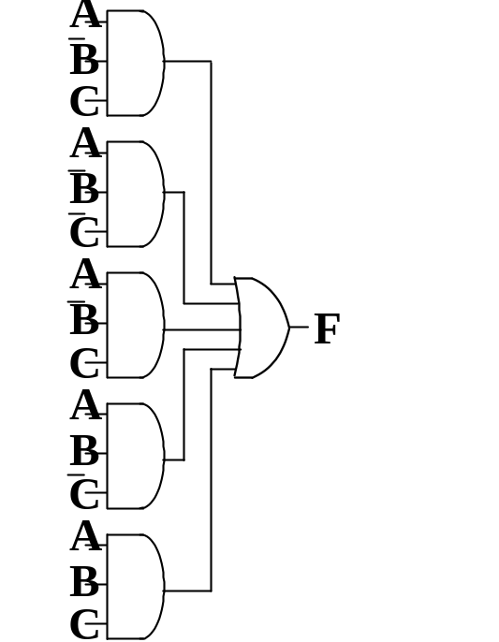
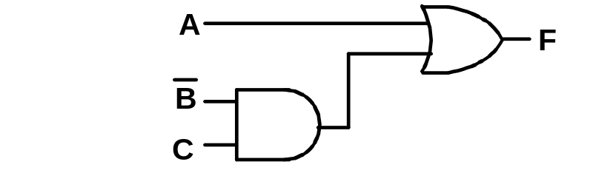
AND/OR Two-level Implementation of SOP Expression
The two implementations for F are shown below – it is quite apparent which is simpler!
Chapter 2 - Part 1 <number>

Slide 60
SOP and POS Observations
The previous examples show that:
  Canonical Forms (Sum-of-minterms, Product-of-Maxterms), or other standard forms (SOP, POS) differ in complexity
  Boolean algebra can be used to manipulate equations into simpler forms.
  Simpler equations lead to simpler two-level implementations
Questions:
  How can we attain a “simplest” expression?
  Is there only one minimum cost circuit?
  The next part will deal with these issues.
Chapter 2 - Part 1 <number>

